Slide 1


Spatial Analysis in R: An introduction to data manipulation, spatial data analysis and statistical modeling Day 4 Nonparametric statistics and Random Forests
Jeffrey S. Evans, Ph.D.,
Senior Landscape Ecologist & Biometrician
The Nature Conservancy | Protected Lands Science
Visiting Professor | University of Wyoming | Zoology & Physiology
Laramie, WY | jeffrey_evans@tnc.org | (970) 672-6766

Slide 2
Nonparametrics - Advantages
Distribution Free - do not rely on assumptions that the data are drawn from a given probability distribution
Model Not Fixed – Parameter space can grow to accommodate model fit
Dimensionality - Suitable for complex, high dimensional problems
Nonlinearity – Many methods can accommodate nonlinear problems
Autocorrelation - Does not assume iid and as such are not effected by autocorrelation
Optimal predictors – Because of fitting to the data, they tend to provide belter predictions

Slide 3
Nonparametrics - Disadvantages
Can be difficult to draw inference - Because of the “black box” nature of some methods and the complexity of the state space.
No direct spatial process term - Methods do not allow for incorporating spatial term (e.g., conditional autoregressive, polynomial trend).
Spurious correlations - Data mining can lead to selection of variables that have no ecological relevance.

Slide 4
Incorporating spatial process
Parameters
Naïve – [X,Y]
Trend – Nth order polynomial
Distance matrix
Neighbor score or weight
Conditioning data
Spatially lagged dependent variable
Spatial Moving Average – adjust estimate
Caution: the spatial process may already be accounted for in nonstationarity of covariates

Slide 5
Nonparametric Methods
Spearmen’s Rank Correlation
Kolmogorov-Smimov Distribution Test
Hierarchal Bayesian models
Gradient Boosting
Nearest Neighbors and Prototypes
Cluster Analysis (K-Means, K-Medoid, Fuzzy C-Means)
Support Vectors (SVM)
Imputation (Canonical Regression)
Kernel Density Estimate
Semiparametric Regression (Splines, Kernels, Wavlets)
Neural Networks
Ensemble Learning (Random Forests)
Multivariate Adaptive Regression Splines

Slide 6
Monte Carlo and Markov Process
Monte Carlo - Repeated randomizations or realizations of data
Convergence on true characteristics of data
Uncertainty
Markov Process - Conditional probability based on previously observed data (probability chains)
MCMC (Monte Carlo Markov Chains)
Posterior probability distributions
Transitional probabilities
Convergence on PDF

Slide 7
High Dimensional Data (hypervolumes)
Curse of dimensionality?
Complex state space is a reality in ecological problems (the world is complex)
Limited methods that can account for high dimensional state spaces
More complex, nonlinear data becoming available
Concept follows the niche hypervolume
Latent (hidden) Variables
Asymptotic Distributions

Slide 8
Random Forests

Slide 9
Random Forests Model
Nonparametric Bootstrap
34% out of bag (OBO) random sample
Classification and Regression Trees
Permutated variables at each node
Provides robust model fitting
Provides variable importance
Breiman 2001; Liaw and Wiener 2005

Slide 10
Ensemble (Weak) Learning
Bootstrapping - Multiple random realizations of data (with replacement)
Any single randomization is a less than optimal representation of data
Converges on stable estimate
Estimation based on “voting” across ensemble
Converges on stable estimate of probability distribution akin to MCMC

Slide 11
Bootstrapping
Historically used to estimate error of sample distribution (testing iid) by estimating standard errors and confidence intervals
Used when (Ader et al., 2008):
Theoretical distribution is complicated or unknown
Sample size is insufficient for statistical inference
Power calculations have to be derived
Extended to provide a randomization framework for constructing model ensembles.
Bootstrap estimate of each weak learner is based on sample with replacement

Slide 12
Classification and Regression Trees
Can use continuous, nominal, categorical and ordered data.
Creates node splits using brute-force greedy search through entire variable space
Uses entropy (Shannon’s or GINI Index) for quantifying node impurity (i.e., S=0 for single class)
Entropy Index represents probability distribution throughout recursive partitions

Slide 13
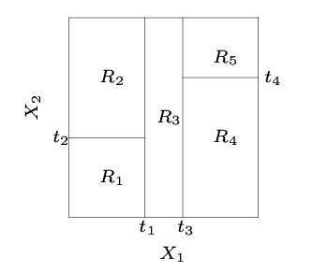
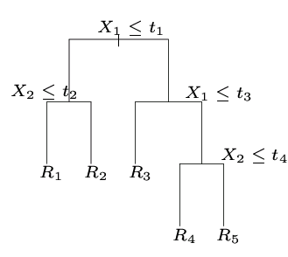
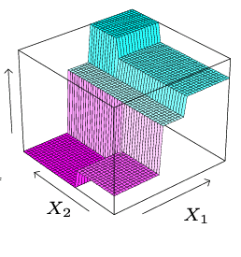
Classification and Regression Trees
Empirically related to SVM, K-Means, Hierarchical clustering, etc…
Utilizes margin function (partition vector)

Slide 14
Classification and Regression Trees
Partition the space into M regions:
R₁, R₂, …, R_{M}.

Slide 15
Classification and Regression Trees
The best partition: to minimize the sum of squared error:
Greedy algorithm: at each level choose variable j and value s as:

Slide 16
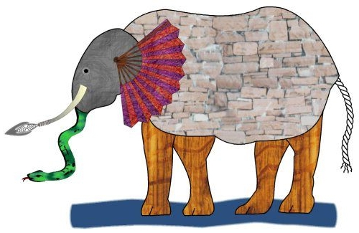
Classification and Regression Trees
It was six men of Indostan ; To learning much inclined, Who went to see the Elephant; (Though all of them were blind), That each by observation; Might satisfy his mind …. -- “The Blind Men and the Elephant” by John Godfrey Saxe (1816-1887)

Slide 17
Random Forests
CART’s require a Cost Complexity parameter to limit depth (number of splits) of partitions and requires pruning to avoid overfit
Because in Random Forests, CART’s are gown to full depth the model does not require complexity criteria or pruning parameters
Convergence provides more detailed estimate (better picture of elephant)
Hierarchical nature of partitioning provides balance of 1st and 2nd order variation
Can account for interactions in high-dimensional space
Reviles Latent (hidden) Variables

Slide 18
Random Forests
The algorithm can be explained by:
1. Iteratively construct N Bootstraps (with replacement) of size n (36%) sampled from Z, where N is number of Bootstrap replicates (trees to grow) and Z is the population to draw a Bootstrap sample from.
2. Grow a random-forest tree T_{b} at each node randomly select m variables from M to permute through each node to find best split by using the entropy index to assess information content and purity. Grow each tree to full extent with no pruning (e.g., no complexity parameter).
3. Using withheld data (OOB, out-of-bag) to validate each random tree Tb (for classification OOB Error; for regression pseudo R² and mean squared error).
4. Output ensemble of random-forest trees

Slide 19
Random Forests
Node permutated variables
Bootstrap Sample
|
NDVIC< 0.06834
NDVIC>=0.06834
HIGH
NBR< 0.07883
NBR>=0.07883
n=1000
HIGH
NBR< 0.3633
NBR>=0.123
NBR>=0.3633
NBR< 0.123
NDVIC< 0.1859
NDVIC>=0.1859
HIGH MIXEDHIGH MIXED
NDVIC< 0.1181
NBR>=0.222
NBR< 0.222
Predict to OOB

Slide 20
Random Forests
To make an estimate for regression
To make an estimate for classification

Slide 21
Random Forests
Proximities
Proximities form a NxN matrix for each tree. If case i and case j both occur in the same terminal node, increase the similarity between i and j by 1

Slide 22
Model Validation
Model Performance
Test against OOB sample
No need for independent validation?
Conservative estimate of performance
Independent validation
Randomization (p-value)
n-Fold Cross Validation
AUC/ROC (Autocorrelation adjusted)
Kappa (PCC with correction for expected random effect)
Mean Squared Error of PDF

Slide 23
Multi-colinearity
Not same as colinearity
(linear relationship between x and y)
Represents redundancy in n-dimensional space
Inflation of model error (opposite effect than on linear models)
QR matrix-decomposition identifies variables exhibiting multivariate redundancy

Slide 24
Class Balance Problem
Occurs when sample distribution is highly Skewed and Kurtotic (i.e., Zero Inflation)
Bias in Bootstrap (not truly random)
Correlation in ensemble (overfit)
Error and estimation bias towards majority class or median of distribution (which can center very close to 0)

Slide 25
Class Balance Problem
Proposed Solution(s)
Replicate (up-sample) minority class
Create synthetic up-sample of minority class
Evans and Cushman (2009) Solution
Randomize within majority class or percentile to down-sample to approximation of Minority n²
Run independent RF model for each down-sampled randomization with fixed parameters
Test against covariance of full data until convergence
Multi-model estimation (combine independent ensembles)

Slide 26
Model Selection (Murphy et. al., (2010); Evans et. al., (2011)
1) Scale Mean Improvement ( MIA / MAX(MIA) )
2) Subset variables by ratio and re-run model
3) Optimize on model error
Variable Importance using ratio of mean improvement in accuracy based on permutation of x at each node (m parameter)
Murphy M, J.S. Evans, A. Storfer (2010) Quantify ecological process at multiple spatial scales using landscape genetics: Bufo boreas connectivity in Yellowstone National Park. Ecology 91:252-261
Evans J.S., M.A. Murphy, Z.A. Holden, S.A. Cushman (2011). Modeling species distribution and change using Random Forests in Predictive species and habitat modeling in landscape ecology: concepts and applications. eds Drew CA, YF Wiersma, F Huettmann. Springer, NY

Slide 27
Test percentiles of scaled variable importance
Permutated variables
Bootstrap Sample
n=5000
Model selection
|
NDVIC< 0.06834
NDVIC>=0.06834
HIGH
NBR< 0.07883
NBR>=0.07883
HIGH
NBR< 0.3633
NBR>=0.3633
NBR>=0.123
NBR< 0.123
NDVIC< 0.1859
NDVIC>=0.1859
HIGH MIXEDHIGH MIXED
NDVIC< 0.1181
NBR>=0.222
NBR< 0.222
Predict to OOB
Minimized error

Slide 28
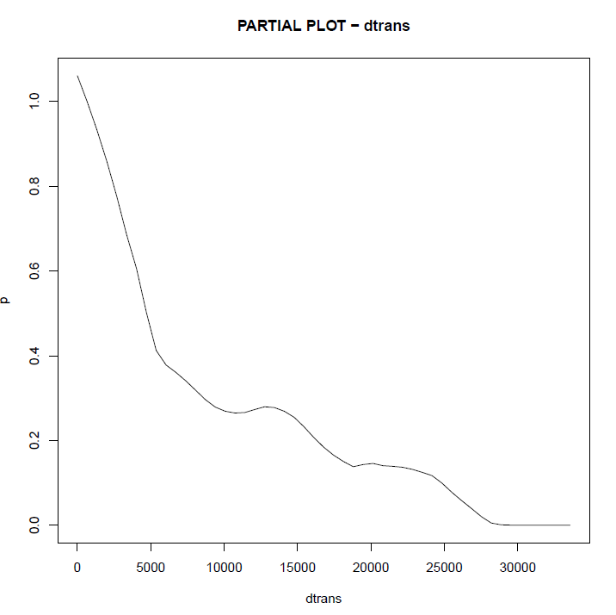
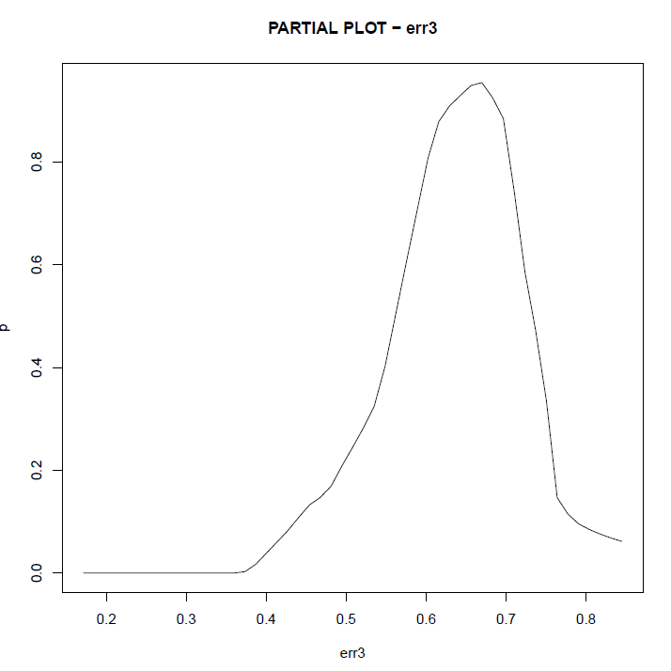
Partial Plots – Statistical Margin
Functional Statistical Relationships

Slide 29
RF with Presence-Only Data
Presence/Absence data
Result of better sample design
Can account for competition
More model options
Presence-only data
What is presence-only data
Model fallacy
Opportunistic (data tends to be biased)
Few model options

Slide 30
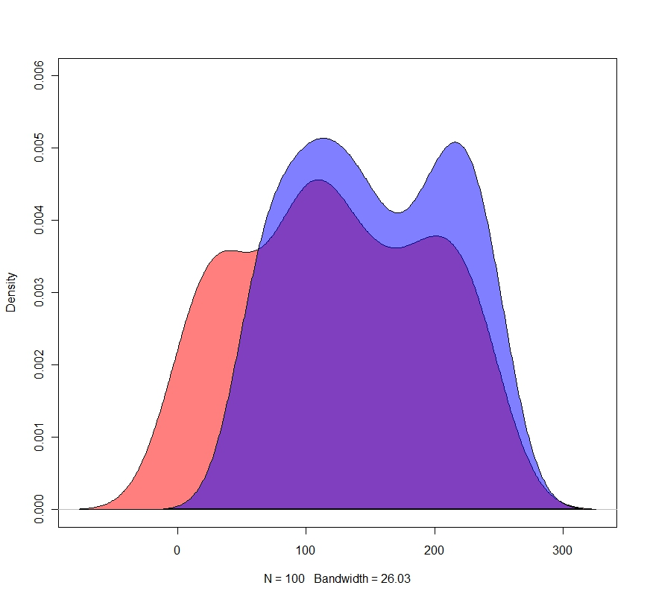
Data issues - Statistical Variability
Capturing population distribution in sample
Range of variability
Influences quality of model
Blue - Sample distribution
Red - Population distribution
Captured
variability
Missing variability

Slide 31
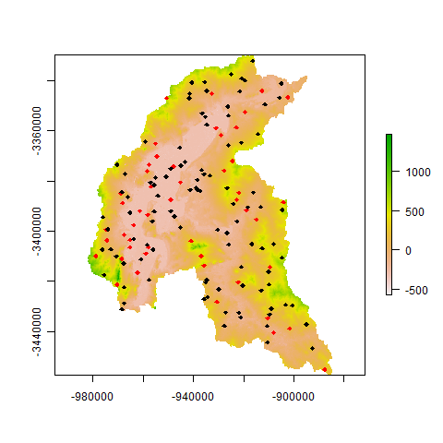
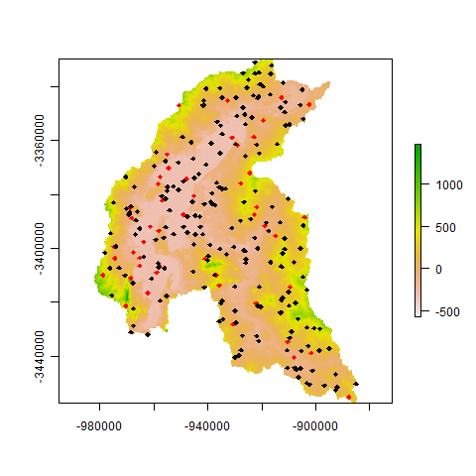
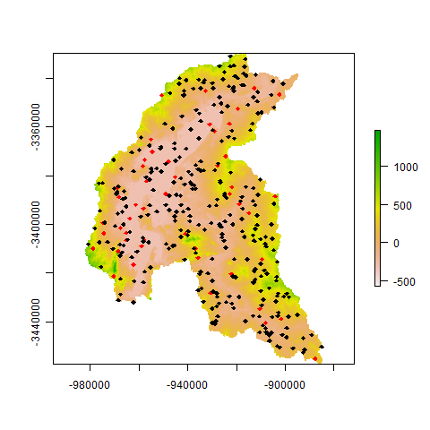
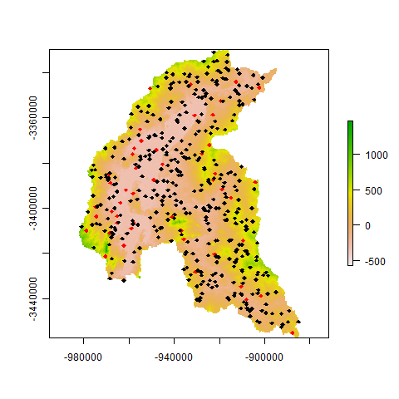
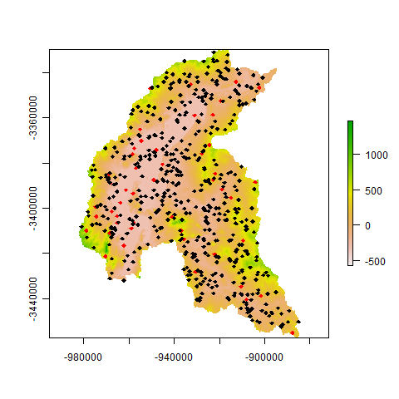
Data issues - Spatial Variability

Slide 32
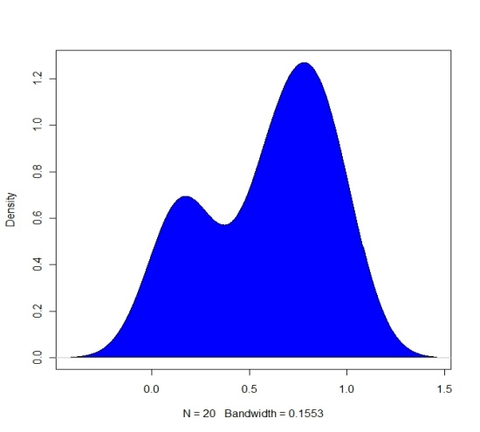
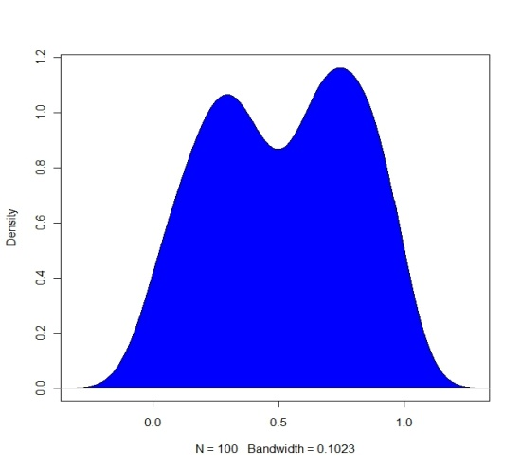
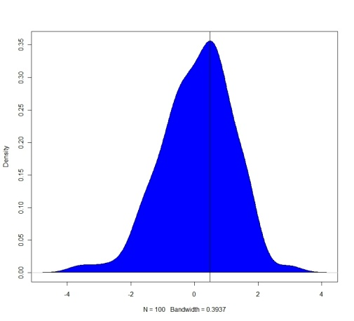
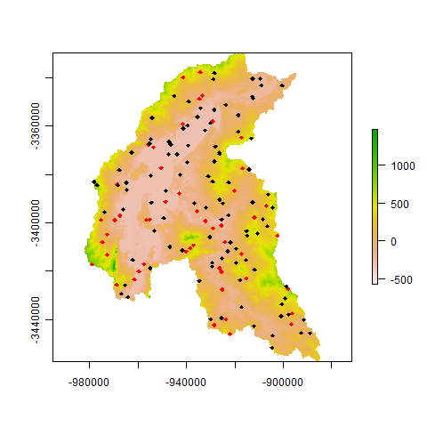
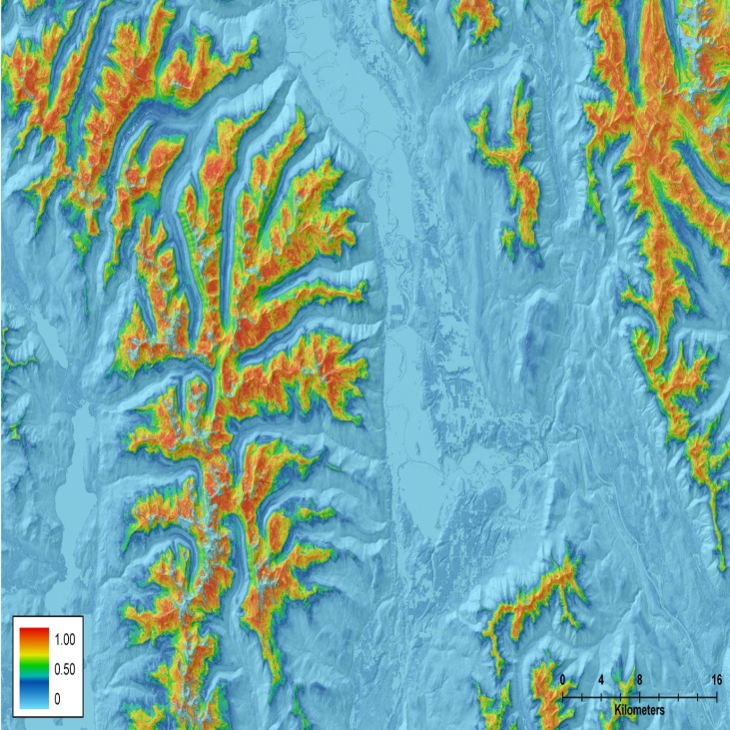
Multi-model estimation
Models [1…n]
Estimates [1…n]
Distribution Test
(Kolmogorov-Smirnov)
Final
estimate
Models are Combined or estimates averaged

Slide 33

Lessons learned

Slide 34
Case Studies

Slide 35
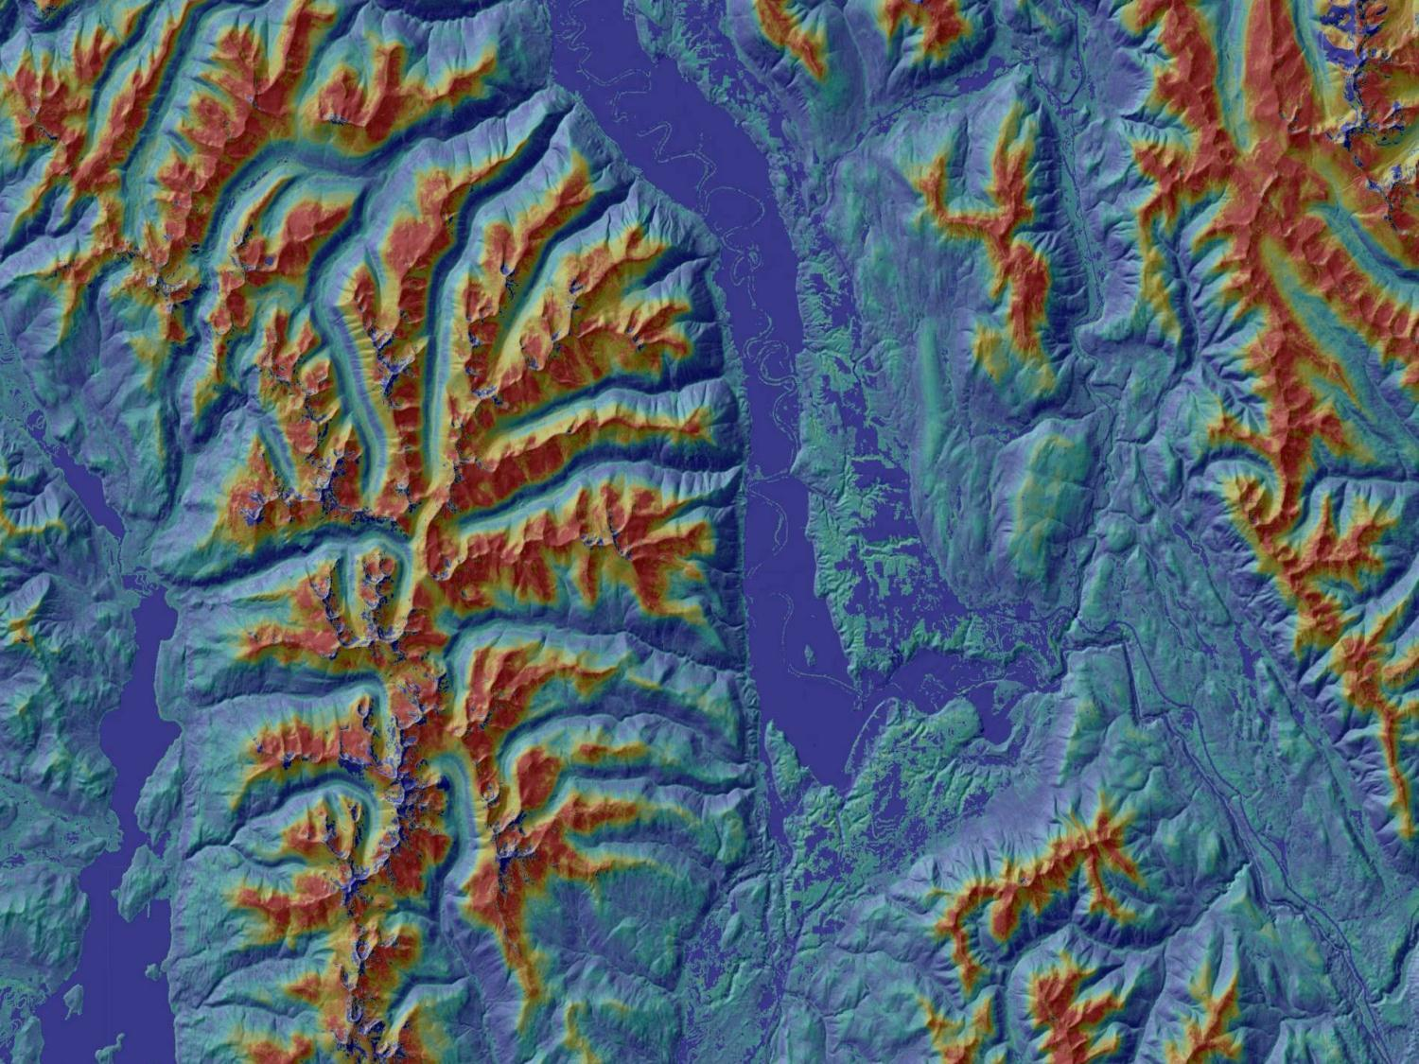
Gradient Niche Modeling
Evans, J.S. and S.A. Cushman (2009) Gradient Modeling of Conifer Species Using Random Forest. Landscape Ecology 5:673-683
Cushman, S.A, K. McGarial, K. Gutzwiller and J.S. Evans. (2010). The gradient paradigm: A conceptual and analytical framework for landscape ecology. Chapter 5 in S.A. Cushman and F. Huettman (eds). Spatial Complexity, Informatics and Wildlife Conservation, Springer, New York
Evans J.S., M.A. Murphy, Z.A. Holden, S.A. Cushman (2011). Modeling species distribution and change using Random Forests in Predictive species and habitat modeling in landscape ecology: concepts and applications. eds Drew CA, YF Wiersma, F Huettmann. Springer, NY

Slide 36
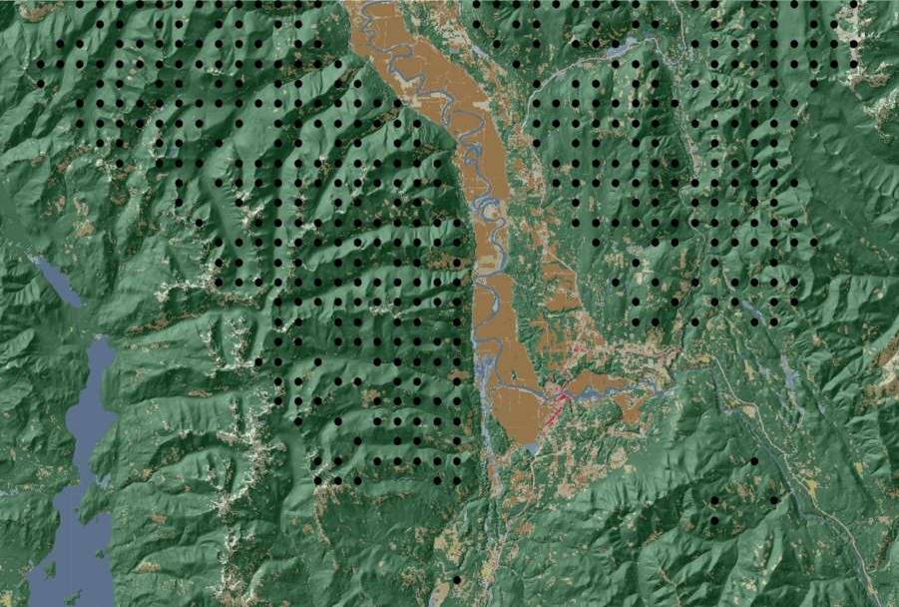
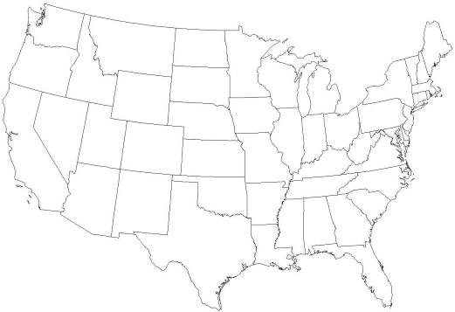
Study Area – 959,712 acres
Northern Idaho, USA
433 Intensified FIA plots

Slide 37
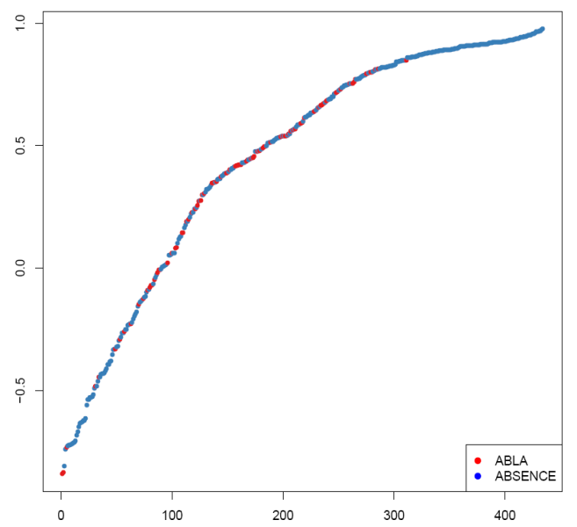
Gradient Models
Model Margin Function
Multi-dimensional Scaling of proximity matrix
OOB Error estimate 21%
Significant at p=0.05
Independent error rate = 10%
Top 4 variables:
Elev, tdiff, ami, dd0
 | ABLA | ABS | ERROR
ABLA | 76 | 17 | 0.18
ABS | 75 | 266 | 0.21

Slide 38

Niche Probability
Probability (p) of Abies lasiocarpa

Slide 39

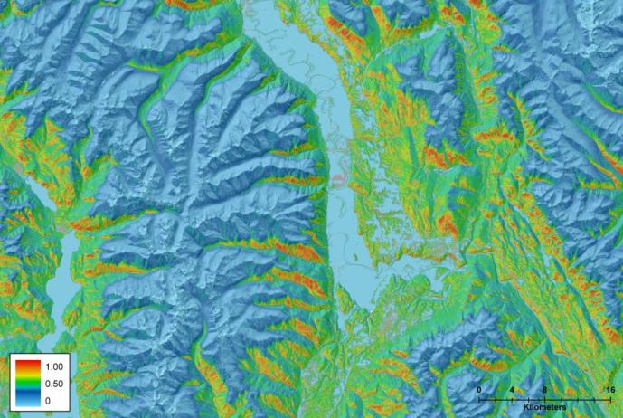
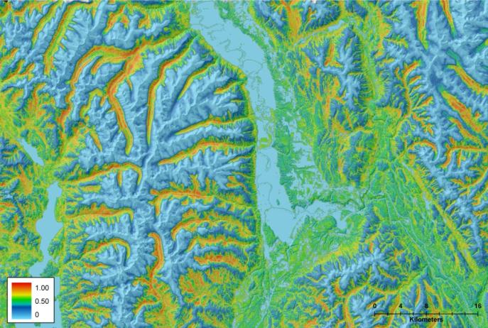
Niche Probability
Probability (gradient) surfaces of three species

Slide 40
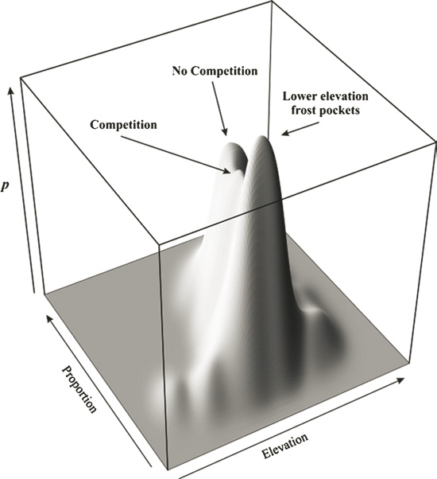
Bivariate Kernel Density
Estimates (KDE)

Slide 41
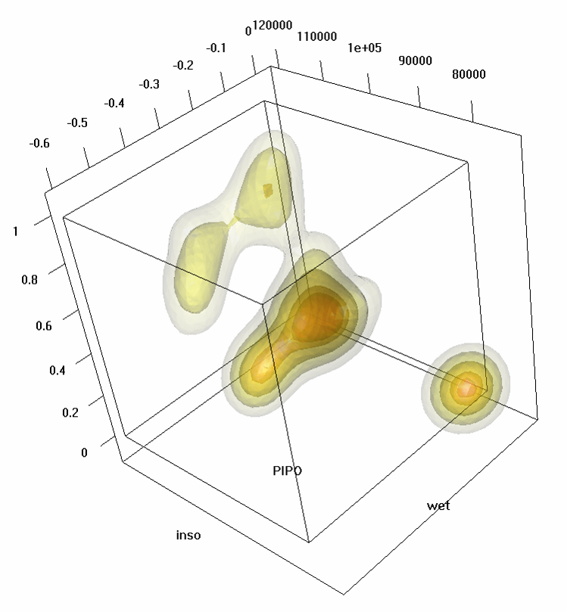
Multivariate Kernel Density
Estimates (KDE)
Volumetric (multivariate) approaches

Slide 42
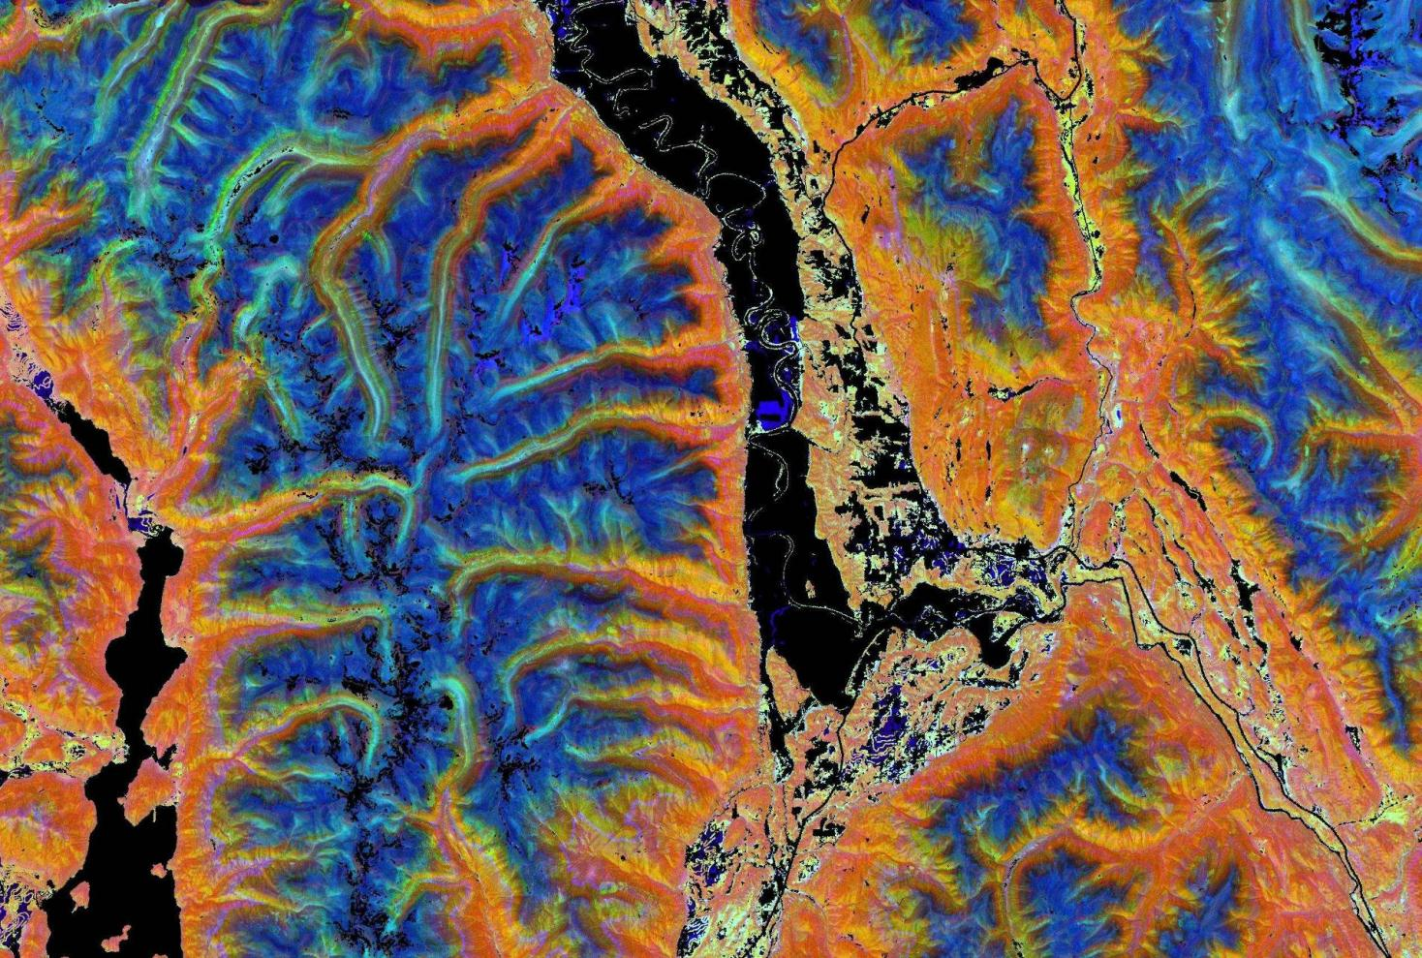
Niche Diversity
Cumulative Probability Distribution
Species (Niche) Diversity

Slide 43
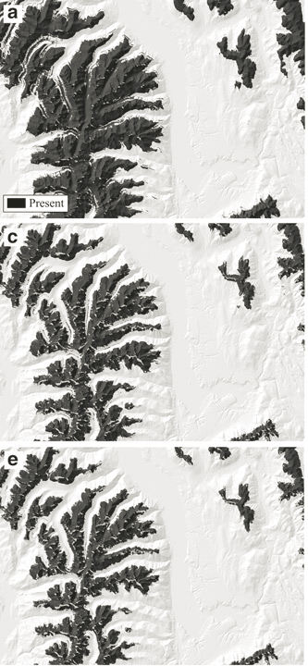
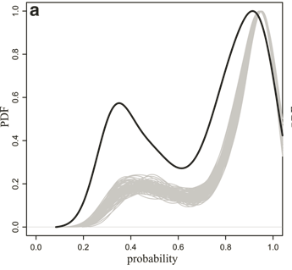
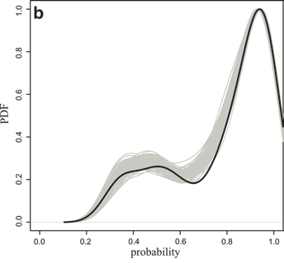
A. Lasiocarpa 2000
Monte Carlo
A. Lasiocarpa 2040
A. Lasiocarpa 2080

Slide 44
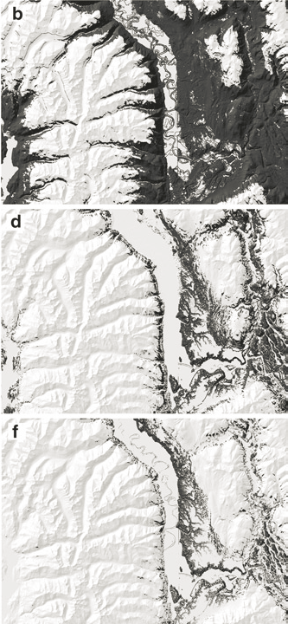
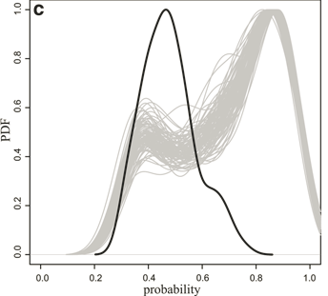
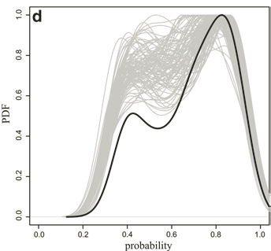
P. Menziesii 2000
Monte Carlo
P. Menziesii 2040
P. Menziesii 2080

Slide 45
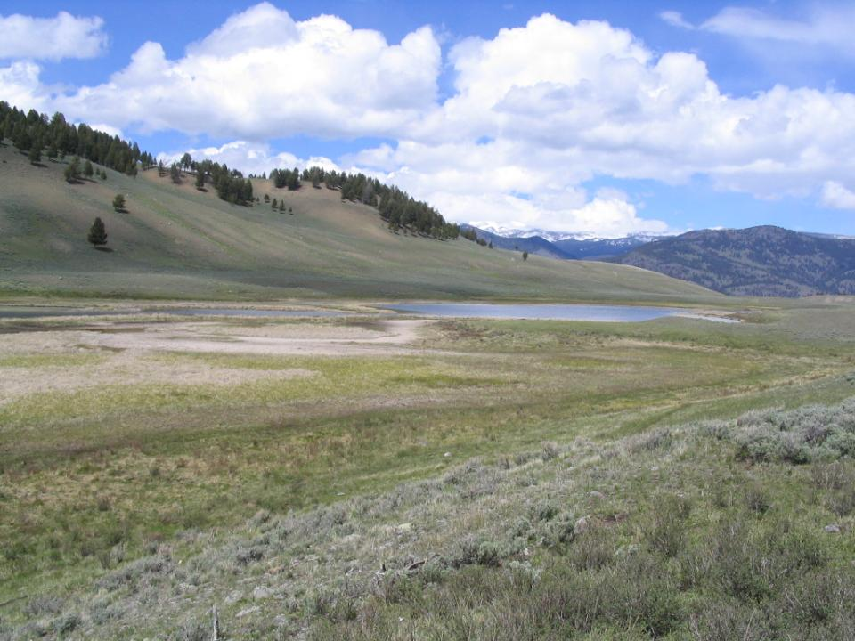
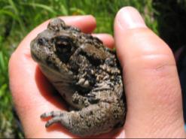
Functional Connectivity of Bufo boreas
Murphy M, J.S. Evans, and A. Storfer (2010) Quantifying Bufo boreas connectivity in Yellowstone National Park with landscape genetics. Ecology 91:252-261
Murphy, M.A.,& J.S. Evans (2011) Genetic Patterns as a Function of Landscape Process: Application of Neutral Genetic Markers for Predictive Modeling in Landscape Ecology in Predictive species and habitat modeling in landscape ecology: concepts and applications. eds Drew CA, YF Wiersma, F Huettmann. Springer, NY

Slide 46
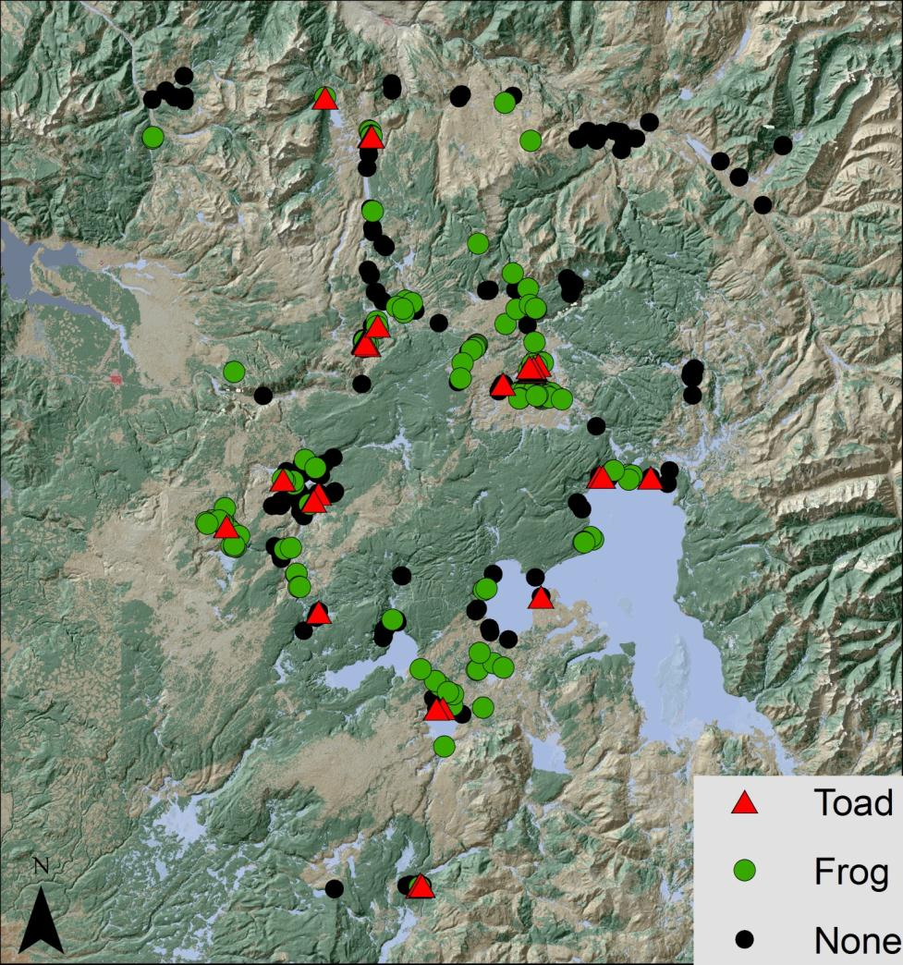
Graph Theory
Notes:
Boreal toads
Patchy distribution
Large clutches
6000 m dispersal
Thermal sites
Muddy substrate
In decline (?)
Continuous distribution
Smaller clutches
600 m dispersal
Non-thermal
Emergent vegetation
Stabile (?)

Slide 47
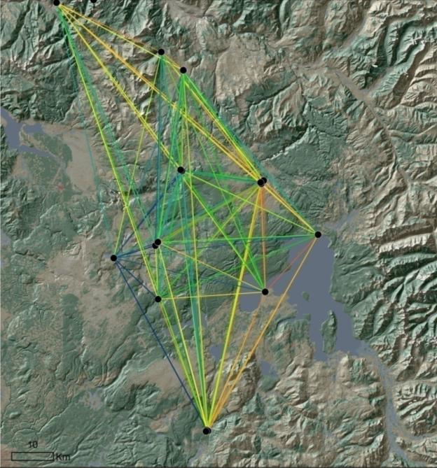
Graph Theory
Notes:
Boreal toads
Patchy distribution
Large clutches
6000 m dispersal
Thermal sites
Muddy substrate
In decline (?)
Continuous distribution
Smaller clutches
600 m dispersal
Non-thermal
Emergent vegetation
Stabile (?)

Slide 48
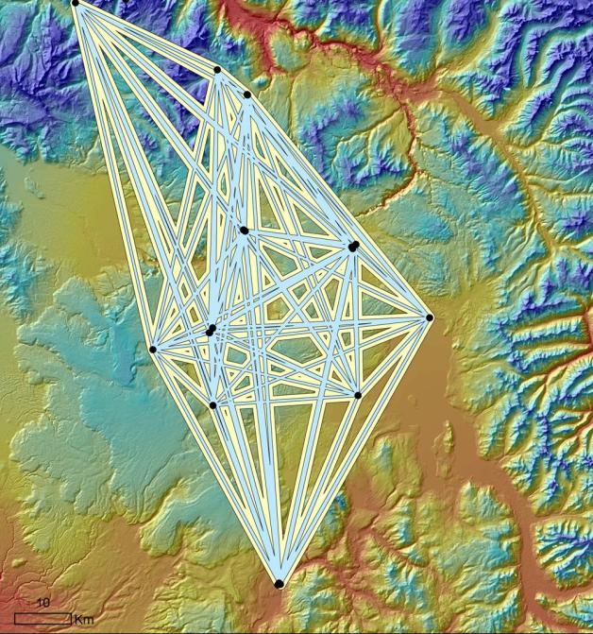
Multi-scale Analysis

Slide 49
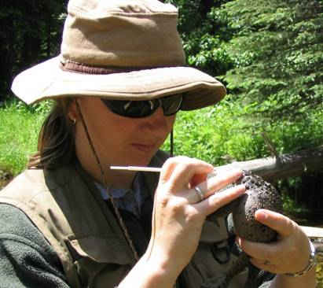
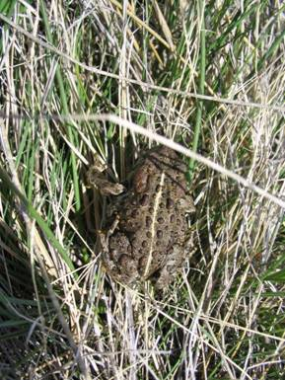
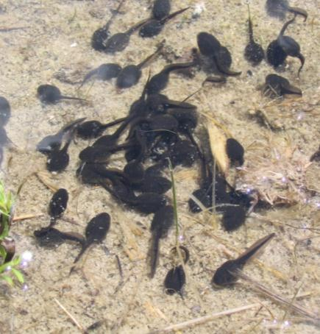
Tissue Collection
2004-2006
30-60 samples/site (n=806)
(Goldberg et al 2003)
Microsatellite genotypes (n=15)
(Simandle et al 2006)
Screened for siblings
(C. Goldberg in prep; COLONY - Wang 2004)

Slide 50

Hypothesis Testing
Isolation By Distance
Ecological Factors:
Habitat Permeability
Topographic Morphology
Temperature-Moisture
Metrics Sampled (30m)
Dps

Slide 51
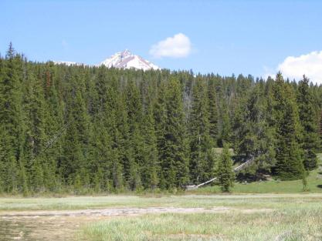
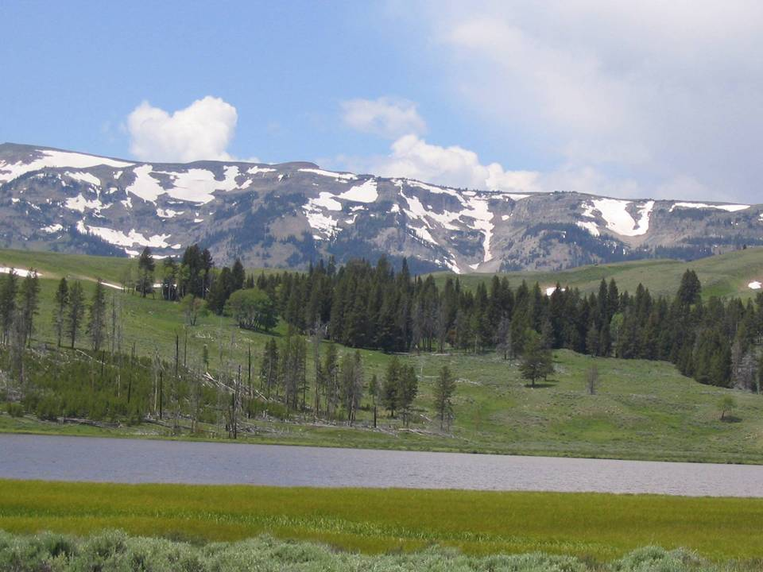
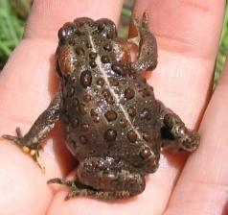
Isolation By Distance
21% Variation explained

Slide 52
Habitat Permeability:
burn, cover, roads/development, thermal
51.80% Variation explained

Slide 53
Topographic Morphology:
Hierarchical slope position, elevation
Topographic complexity
(Roughness, Elevation Relief Ratio)
53.57% Variation explained

Slide 54

Temperature-Moisture:
Growing season precipitation
55.30% Variation explained

Slide 55
Multi-scale analysis
Scale
0
60
120
240
480
960
forest burn roads canopy rough err27 hsp ridge ffp dd5 ssina gsp
Habitat permeability
Topographic morphology
Temp-moisture (Climate)

Slide 56
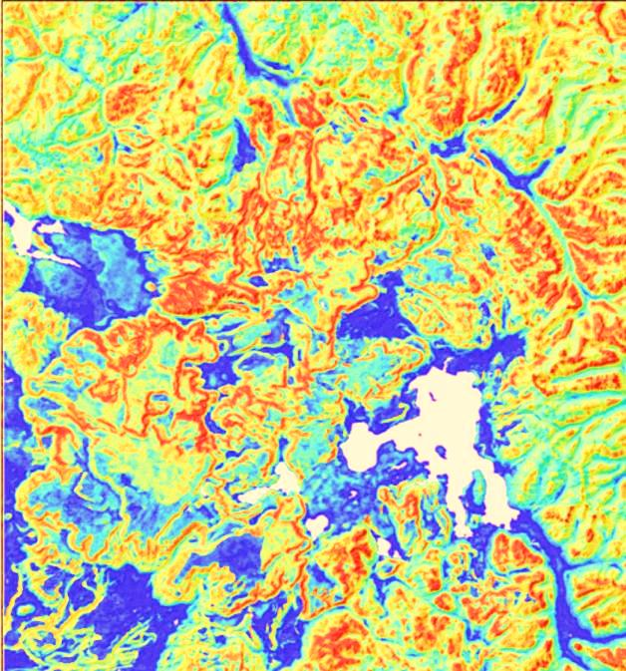
Genetic Distance Estimate
Empirical Cost Surface
Murphy & Evans (2011) Predictive Landscape Ecology

Slide 57
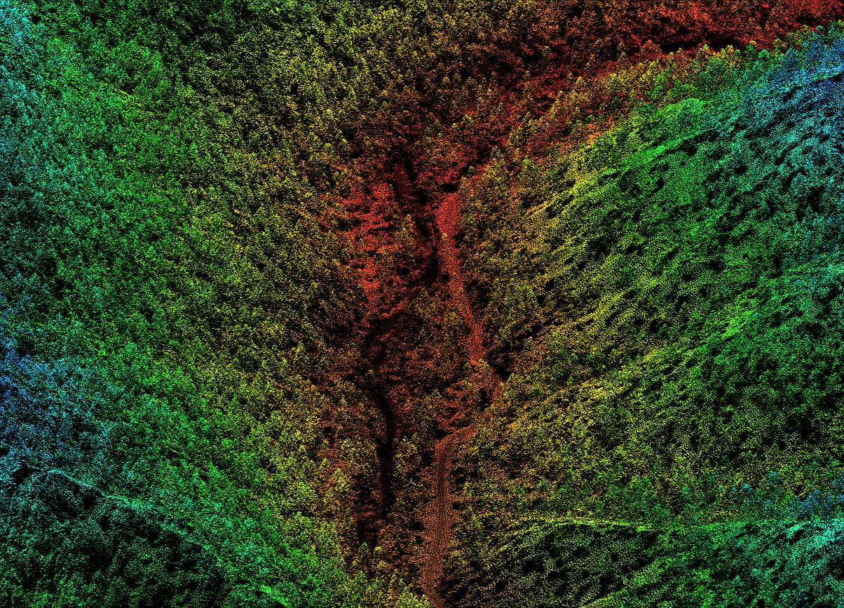
Forest Successional Classification
Using Lidar
Falkowski, M.J., J.S. Evans, S. Martinuzzi, P.E. Gessler, and A.T. Hudak. (2009) Characterizing forest succession with lidar data: An evaluation for the Inland Northwest, USA. Remote Sensing of Environment 113:946-956.
Evans J.S., A.T. Hudak, R. Faux, A.M.S. Smith (2009) Discrete Return Lidar in Natural Resources: Recommendations for Project Planning, Data Processing, and Deliverables. Remote Sensing 1(4):776-794

Slide 58
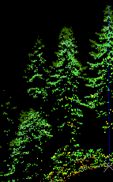
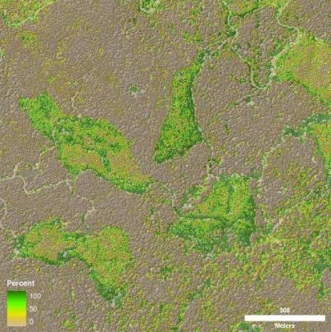
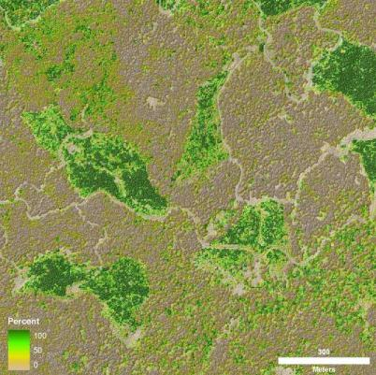
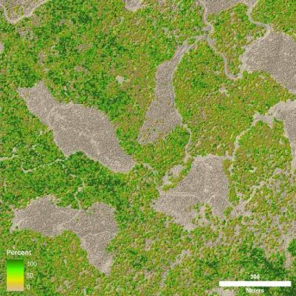
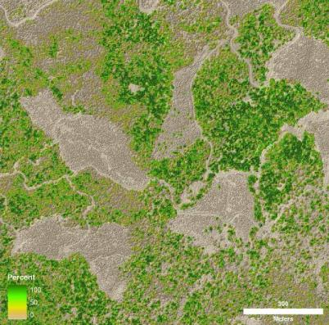
Canopy Volume
Stratum 1
1 – 5 m
Stratum 2
5 - 20 m
Stratum 4
> 30 m
Stratum 3
20 - 30 m
Stratum 3
20 - 30 m
Stratum 4
> 30 m
Stratum 2
5 - 20 m
Stratum 1
1 – 5 m

Slide 59

Height Distributions

Slide 60




Lidar prediction of successional stages

